Slide 1
Final project automation 1
Course Instructor: Dr. Ahmad Taher Azar
Email: Ahmad_t_azar@ieee.org
Website: https://www.sites.google.com/site/drahmadtaherazar
16-Dec-17
Design & Implementation of Keeping Distance with Focus of Infusion Stand as an Application.

Slide 2
Team Members
Hedaya Ali (ID 171103)
Mohd Saiful Akmal Bin Razali (ID 171021)
Gabriel de Brito Silva (ID 171020)
Berit Adina Haendel (ID 171018)

Slide 3
Abstract

Slide 4
Introduction
Infusion Stand is one of the medical supportive tools that not only used extensively in hospitals, clinics, physical practices but also in the supportive care provided in the home. Normally, a conventional Infusion Stand consists of a stand alone metal structure which includes a rod, a chassis which typically equipped with 3, 4 or 5 legs with and a wheels & a hanger with one or more hooks at the upper part of the Infusion Stand. There are a lot of accessories that will be attached to the Infusion Stand such as bags of fluids like a water, medication & blood, urinary hooks, temporary pacemakers, patient handles & support trays.
Meanwhile, keeping ….

Slide 5
Motivation
Research studies from the hospitals, clinics, physical practices and also in the supportive care provided in the home found that one of the main drawback of Infusion Stand that currently available in the market is their difficulty to maneuver freely. When a patient want to move away from a confined area, he or she need to drag their own Infusion Stand or in worse case, to get an assistance from the nurse or any other person nearby him or her. Consequently, the nurse will use up his or her time accompanying the patient itself and serving the patient by dragging the Infusion Stand which ends up give inconvenience to the patient and also unproductive day to the nurse itself. Besides, patient and also nurse complaint about the massive size of Infusion Stand that may causes issues while maneuvering the Infusion Stand.

Slide 6
Objective
There are several objectives for this particular project which are described as follows:
To design and manufacture an Infusion Stand that able to maneuver with a given direction.
To design and implement keeping distance between the Infusion Stand and a person.
To implement a PID controller to control the system appropriately.

Slide 7
Controller Concept
vLsp
Subsystem:
Motor Left
Speed Control
Physical System
Robot moves to new position and the strip reaction influences the new elongation of the joystick.
X
Controller 2
rotation
vLcurr
X
+
+
-1
vRsp
Subsystem:
Motor Right
Speed Control
Y
Controller 1
translation
+
vRcurr
Y
+
Motor Subsystem (example left)
Abbreviations:
vLsp/vRsp = setpoint speed for motor left/right
vLcurr/vRcurr = current motor speed left/right determined by encoder
verrL = error of motor speed left (vLsp-vLcurr)
vLsp
verrL
PWM
Controller
Motor TF
vLcurr
+
-

Slide 8
Schematic Diagram
Joystick
x-axis & y-axis value
Arduino Mega
PWM
Wheel_ Left
Motor_ Left
PWM
L298N H Bridge
PWM
Motor_ Right
Wheel_ Right
Battery

Slide 9
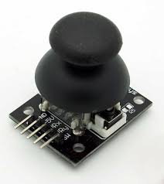
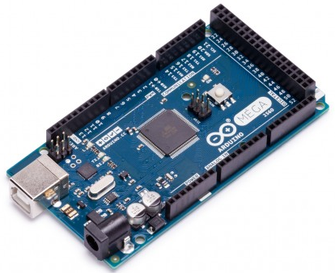
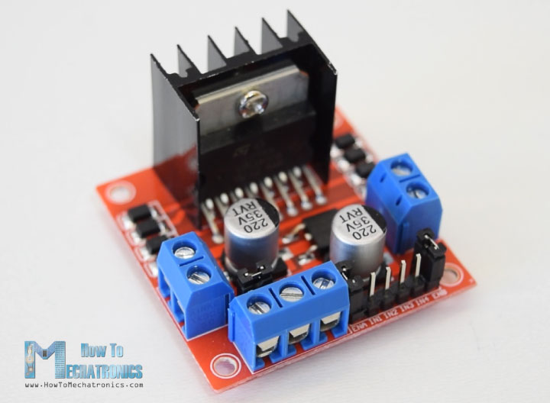
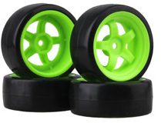
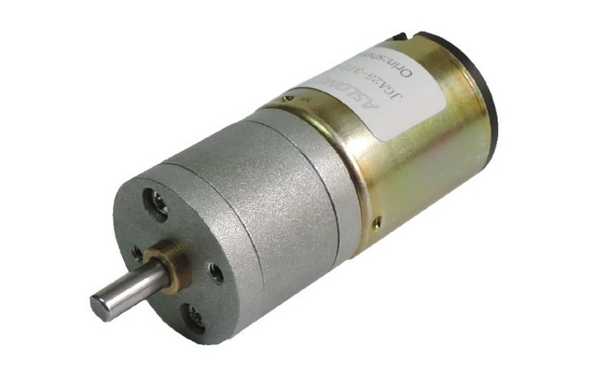
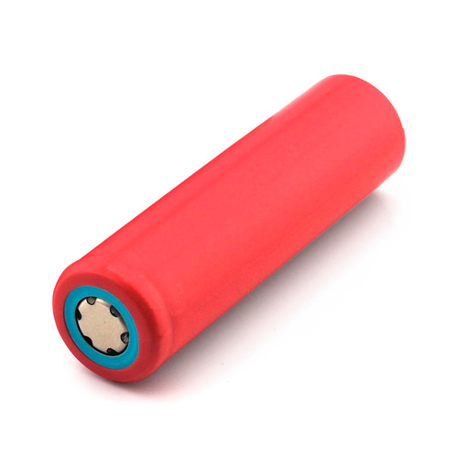
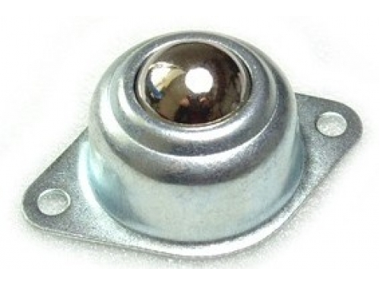
M&E Components
(a)
(b)
(c)
(d)
(e)
(f)
(g)
Figure x: Mechanical & electronic components. (a) Joystick. (b) Arduino Mega. (c) L 298N H Bridge. (d) 65mm wheels. (e) DC Motor. (f) 3.5V Li-Ion Battery. (g) Caster Ball Wheel.

Slide 10
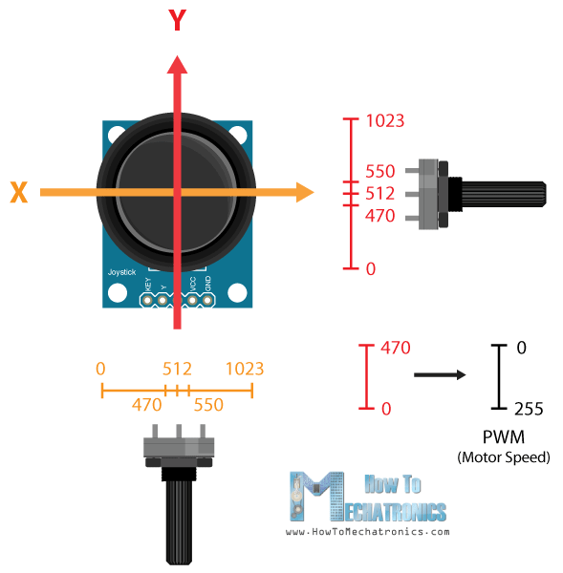
Concept of Joystick
Joystick is theoretically made up of two potentiometers which are connected to the analog inputs of the microcontroller (Arduino Mega). This joystick will have values from 0 to 1023.
Value of the joystick on both axes (x-axis & y-axis) is 512 when the joystick stays in the centre position.

Slide 11
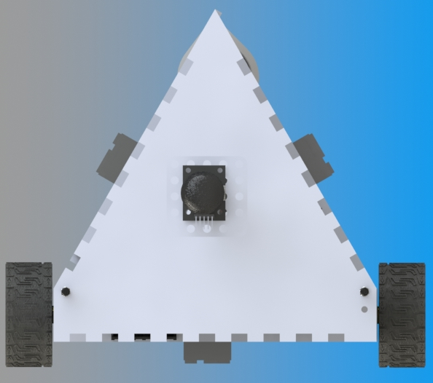
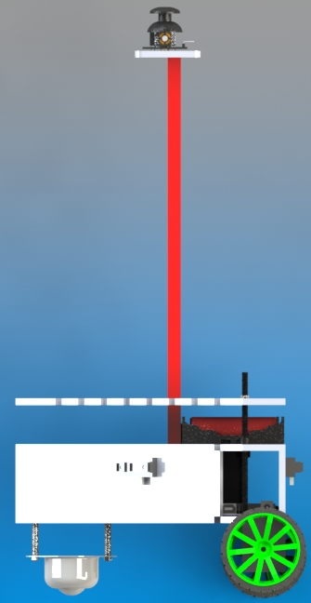
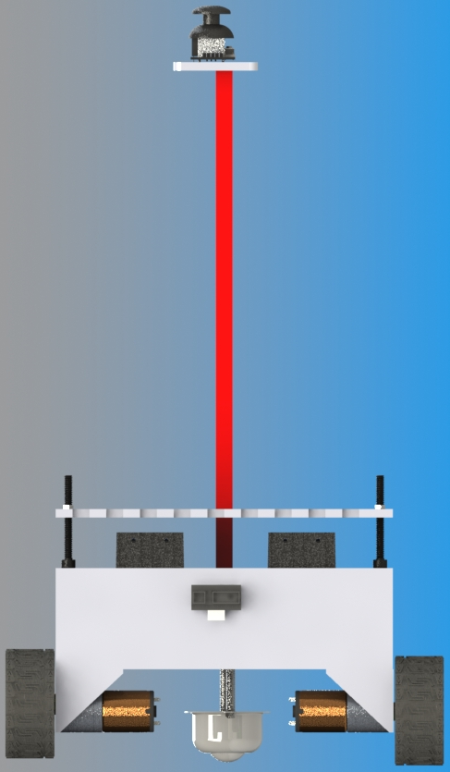
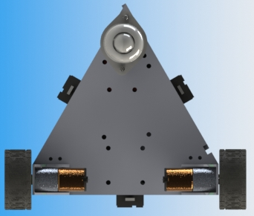
Hardware Design
(a)
(b)
(c)
(d)
Figure x: Hardware Design. (a) Top View. (b) Top-Back View. (c) Back View. (d) Side View.

Slide 12
Exploded View

Slide 13
Conclusion

Slide 14
References
https://www.mathworks.com/help/slcontrol/ug/designing-two-degree-of-freedom-pid-controllers.html?requestedDomain=www.mathworks.com#bsg5g_b
http://ctms.engin.umich.edu/CTMS/index.php?example=InvertedPendulum&section=ControlStateSpace
Ogata „Modern Control Engineering“ (5th Edition)
And the PDF-files in zio-folder

Slide 15


